Slide 1



Wi-Fi Networks in Schools
The New Age of Alchemy

Slide 2
Chris Lockhart – director of technology Princeton City Schools
clockhart@vikingmail.org
chrislock2 - @ twitter

Slide 3


AGENDA
WIFI HISTORY
WIFI BASICS
WIFI STANDARDS
SCHOOL SPECIFIC CHALLENGES

Slide 4
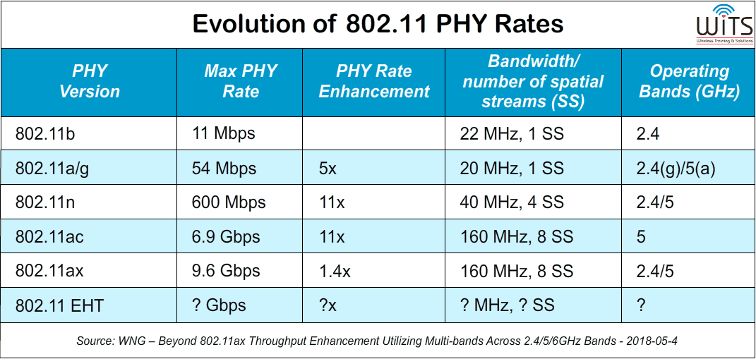
802.11
History
Source:
https://www.wirelesstrainingsolutions.com/future-fi-the-road-to-802-11-2020-and-beyond-chapter-3/
Notes:
1999 - 802.11a 802.11b
2003 - 802.11g (2.4 @54 Mbps backward compatible with drag)
2004 (2003) WPA/WPA2 security to correct flaws in WEP
2009 - 802.11n 600 Mbps! - SU-MIMO (multiple input and multiple output) introduced -
2012 - 802.11ac MU-MIMO (Add multiuser) - 256 QAM with (Wave 2)
Spatial Multiplexing and Beam Forming
2019 - 802.11ax OFDMA - Orthogonal Frequency Division Multiple Access
2.4 GHz is part of the standard

Slide 5
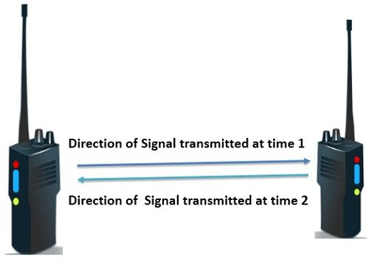
Wifi basics
Wifi relies on radio waves. Radio communications are at their root half-duplex.
Notes:
Wifi has traditionally been a one way street - Half-Duplex
Not only is the street one way, but only one “vehicle” at a time
And if there is any interference, the “vehicle” needs to go back to start

Slide 6
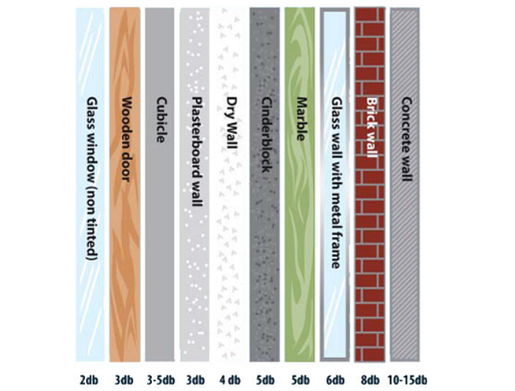
Wifi basics
Different surfaces have difference effects on wifi signals. (Chart shows db attenuation)
Source:
https://www.quora.com/Can-walls-interfere-on-a-WiFi-signal

Slide 7
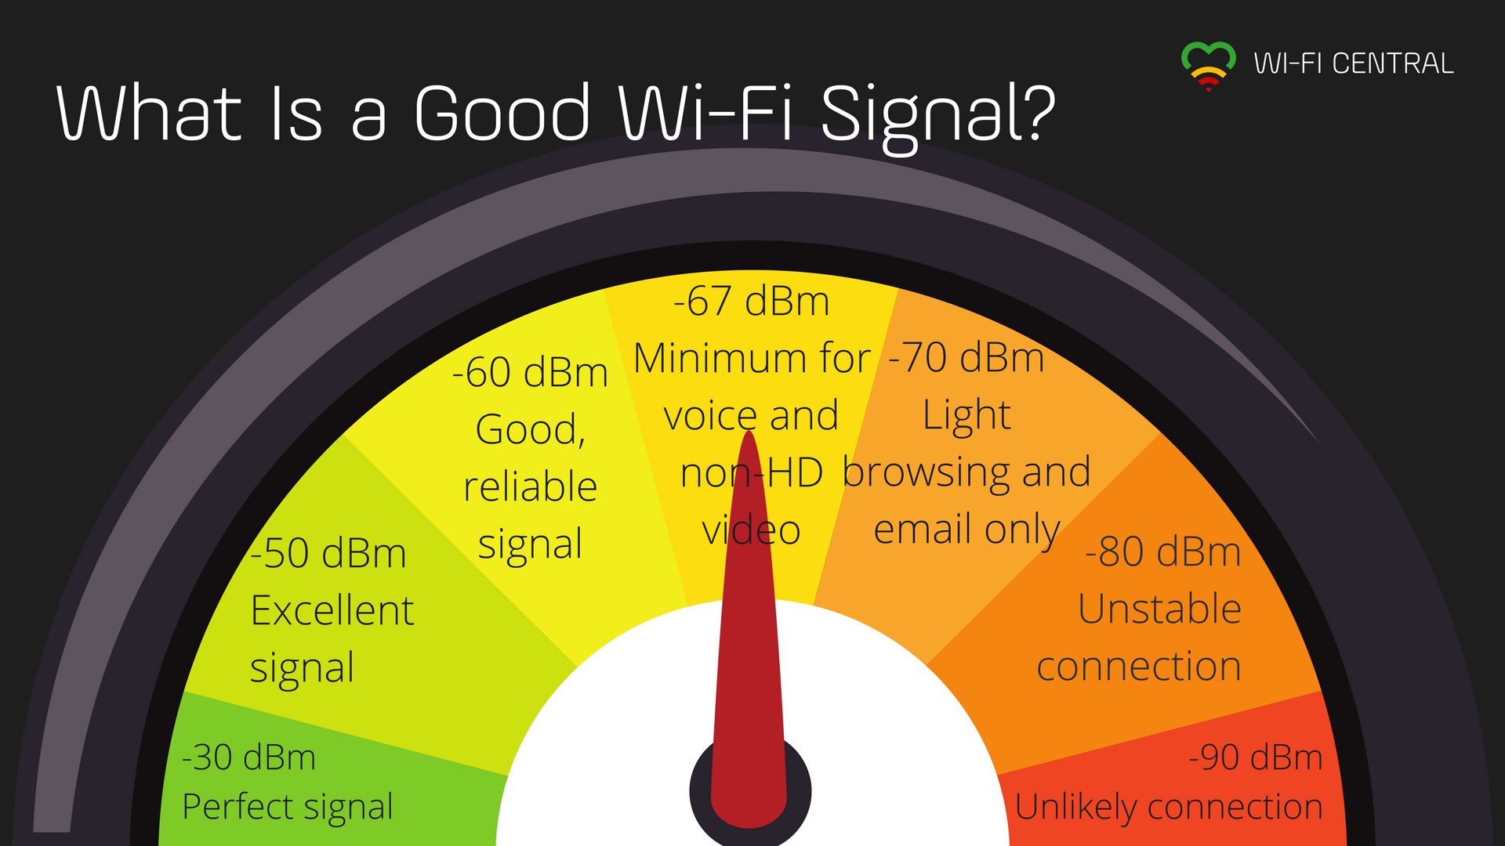
Wifi basics
Recommended signal strength in dBm. Lower is better.
Source:
https://eyesaas.com/wi-fi-signal-strength/

Slide 8
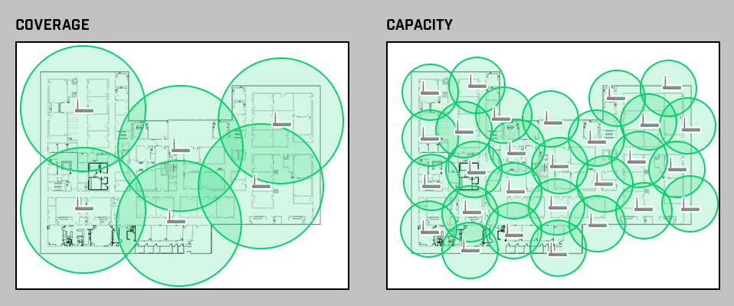

Wifi basics
Schools have moved from a coverage model to a capacity or density model
https://www.accessagility.com/wifi-design-guide

Slide 9
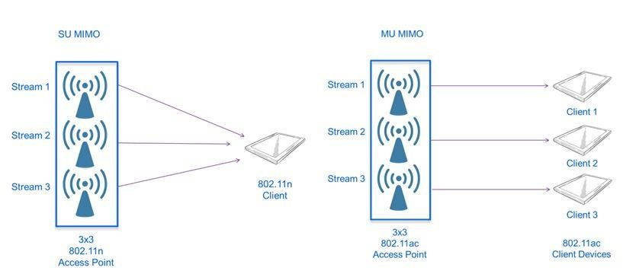
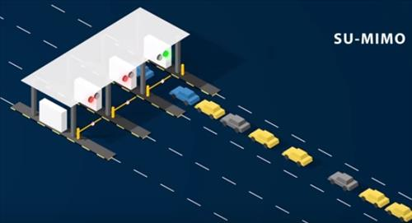
Wifi Standards
802.11n - Introduced su-mimo
SU-MIMO – Single User Multiple Input and Multiple Output
Notes:
2009 - 802.11n 600 Mbps! - SU-MIMO (multiple input and multiple output) introduced -

Slide 10
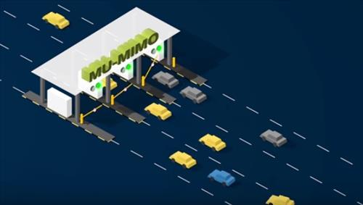

802.11ac - Introduced mu-mimo
MU-MIMO – Multi User Multiple Input and Multiple Output
https://blogs.cisco.com/wireless/cisco-will-ride-the-802-11ac-wave2
https://www.wirelesshack.org/linksys-introduces-mu-mimo-ac-usb-wifi-adapter.html
Notes:
2012 - 802.11ac MU-MIMO (Add multiuser) - 256 QAM with (Wave 2)
Spatial Multiplexing and Beam Forming

Slide 11
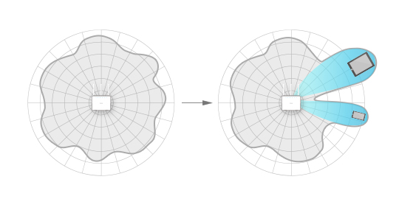
802.11ac - Introduced Beam-Forming
Notes:
2012 - 802.11ac MU-MIMO (Add multiuser) - 256 QAM with (Wave 2)
Spatial Multiplexing and Beam Forming

Slide 12
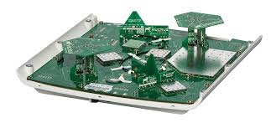
802.11ac - Introduced Beam-Forming
Ruckus Array
Notes:
2012 - 802.11ac MU-MIMO (Add multiuser) - 256 QAM with (Wave 2)
Spatial Multiplexing and Beam Forming

Slide 13
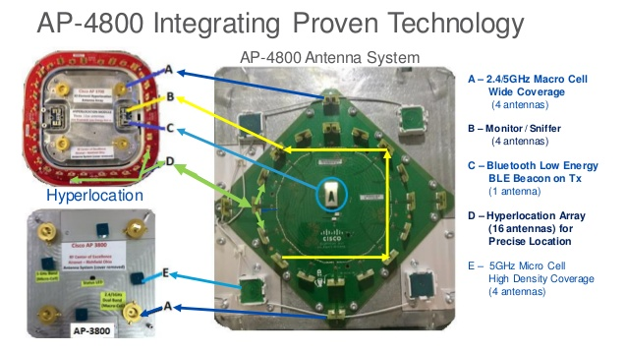
802.11ac - Introduced Beam-Forming
Cisco Array
Notes:
2012 - 802.11ac MU-MIMO (Add multiuser) - 256 QAM with (Wave 2)
Spatial Multiplexing and Beam Forming

Slide 14
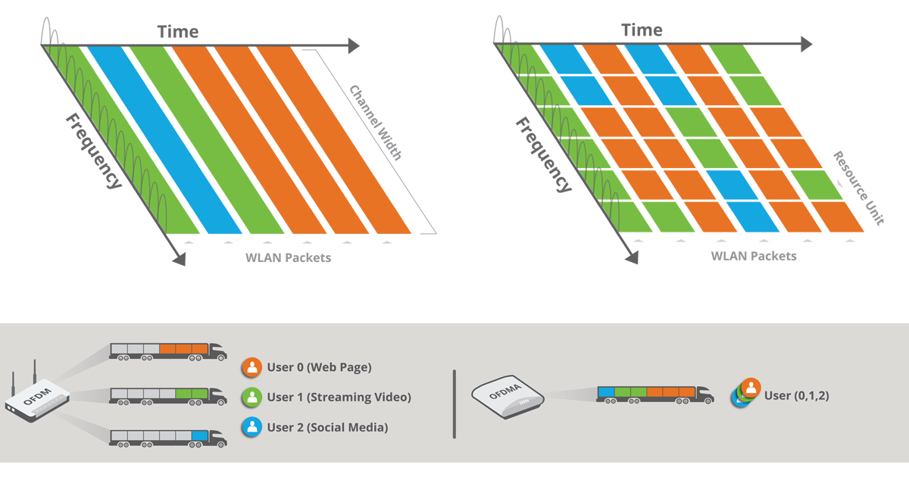
802.11ax - expands ofda to ofdma
OFDMA – Orthogonal Frequency-Division Multiple Access
Notes:
2019 - 802.11ax OFDMA - Orthogonal Frequency Division Multiple Access
2.4 GHz is part of the standard

Slide 15
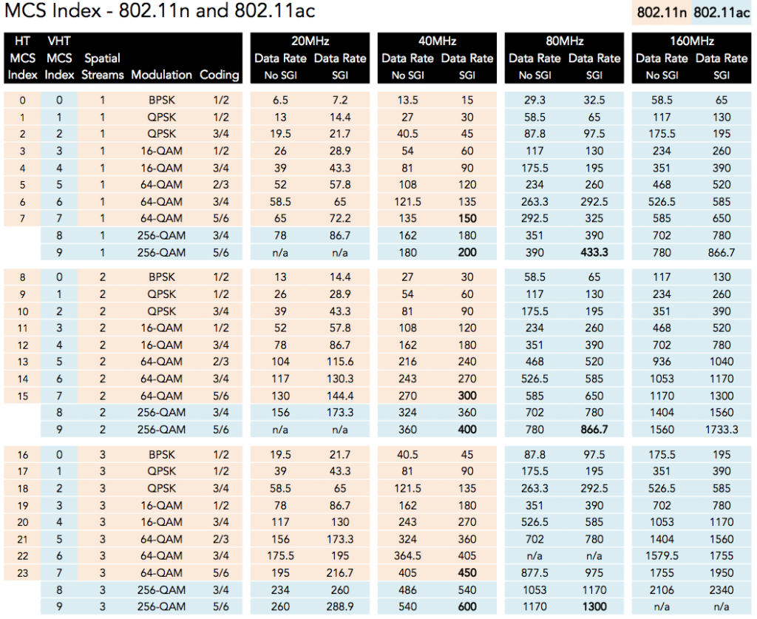
Wifi Standards
Understand the MCS Index 802.11n and 802.11ac.
http://mcsindex.com
Notes:
Modulation and Coding Scheme This is a way to organize data surrounding how transmitters in Wi-Fi prepare data to be sent using various techniques. It is far quicker to say MCS of 7 with 1×1:1… rather than give ALL the details:
SGI = A Short Guard Interval

Slide 16
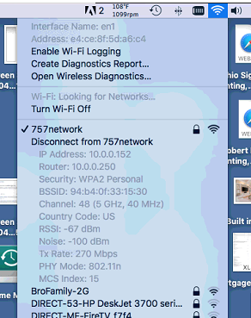
Mac os MCS
Hold down Alt and click Network Icon

Slide 17
School Specific Challenges
Density of devices
  1:1
  Students personal devices
    Phones
    Game systems
    Tablets
    Watches

Slide 18
School Specific Challenges
Security and Filtering
  District owned devices
  BYOD Devices
  Phones or Control system devices
  Public event and guest access

Slide 19
School Specific Challenges
Proximity to Residential wifi
  Single home
  Apartment or multi-unit

Slide 20
School Specific Challenges
Tech Support and Staff
  Troubleshooting
  New Deployments
  Expansion
  Troubleshooting tools
  Variety of clients

Slide 21
School Specific Tips
Invest in a unified system with a controller (on premise or cloud)
Limit your number of SSIDs
Use WPA2 or at least WPA
Avoid Open Networks even on guest (change my mind)
Use LDAP for BYOD or some form of ID management

Slide 22
School Specific Tips
Plan and budget for upgrades

Slide 23

Contact details
Chris Lockhart – director of technology Princeton City Schools
clockhart@vikingmail.org chrislock2 @ twitter

